Slide 1

Slides developed by Mine Çetinkaya-Rundel of OpenIntro
Translated from LaTeX to Google Slides by Curry W. Hilton of OpenIntro.
The slides may be copied, edited, and/or shared via the CC BY-SA license
To make a copy of these slides, go to File > Download as > [option], as shown below. Or if you are logged into a Google account, you can choose Make a copy... to create your own version in Google Drive.

Slide 2
One-sample mean with the t-distribution
Slides developed by Mine Çetinkaya-Rundel of OpenIntro
Translated from LaTeX to Google Slides by Curry W. Hilton of OpenIntro.
The slides may be copied, edited, and/or shared via the CC BY-SA license
Some images may be included under fair use guidelines (educational purposes)

Slide 3
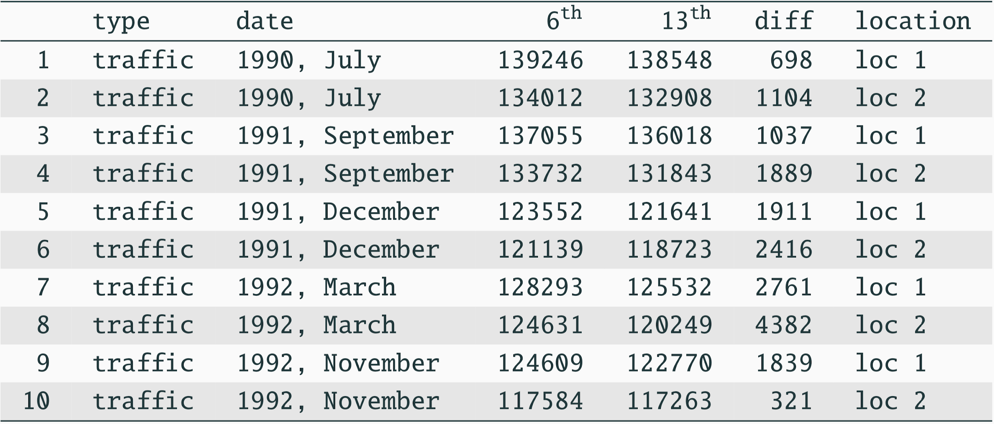
Friday the 13th
Between 1990 - 1992 researchers in the UK collected data on traffic flow, accidents, and hospital admissions on Friday 13th and the previous Friday, Friday 6th. Below is an excerpt from this data set on traffic flow. We can assume that traffic flow on given day at locations 1 and 2 are independent.

Slide 4
Friday the 13th
We want to investigate if people’s behavior is different on Friday the 13th compared to Friday 6th.

Slide 5
Friday the 13th
We want to investigate if people’s behavior is different on Friday the 13th compared to Friday 6th.
One approach is to compare the traffic flow on these two days.

Slide 6
Friday the 13th
We want to investigate if people’s behavior is different on Friday the 13th compared to Friday 6th.
One approach is to compare the traffic flow on these two days.
H₀ : Average traffic flow on Friday 6th and 13th are equal.
H_{A} : Average traffic flow on Friday 6th and 13th are different.

Slide 7
Friday the 13th
We want to investigate if people’s behavior is different on Friday the 13th compared to Friday 6th.
One approach is to compare the traffic flow on these two days.
H₀ : Average traffic flow on Friday 6th and 13th are equal.
H_{A} : Average traffic flow on Friday 6th and 13th are different.
Each case in the data set represents traffic flow recorded at the same location in the same month of the same year: one count from Friday 6th and the other Friday 13th. Are these two counts independent?

Slide 8
Friday the 13th
We want to investigate if people’s behavior is different on Friday the 13th compared to Friday 6th.
One approach is to compare the traffic flow on these two days.
H₀ : Average traffic flow on Friday 6th and 13th are equal.
H_{A} : Average traffic flow on Friday 6th and 13th are different.
Each case in the data set represents traffic flow recorded at the same location in the same month of the same year: one count from Friday 6th and the other Friday 13th. Are these two counts independent?
No!

Slide 9

Hypotheses
What are the hypotheses for testing for a difference between the average traffic flow between Friday 6th and 13th?
H₀ : 𝞵_{6th} = 𝞵_{13th}
H_{A} : 𝞵_{6th} ≠ 𝞵_{13th}
H₀ : 𝙥_{6th} = 𝙥_{13th}
H_{A} : 𝙥_{6th} ≠ 𝙥_{13th}
H₀ : 𝞵_{diff} = 0
H_{A} : 𝞵_{diff} ≠ 0
H₀ : = 0
H_{A} : ≠ 0

Slide 10
Hypotheses
What are the hypotheses for testing for a difference between the average traffic flow between Friday 6th and 13th?
H₀ : 𝞵_{6th} = 𝞵_{13th}
H_{A} : 𝞵_{6th} ≠ 𝞵_{13th}
H₀ : 𝙥_{6th} = 𝙥_{13th}
H_{A} : 𝙥_{6th} ≠ 𝙥_{13th}
H₀ : 𝞵_{diff} = 0
H_{A} : 𝞵_{diff} ≠ 0
H₀ : = 0
H_{A} : ≠ 0

Slide 11
Conditions
Independence: We are told to assume that cases (rows) are independent

Slide 12
Conditions
Independence: We are told to assume that cases (rows) are independent
Sample size / skew:

Slide 13
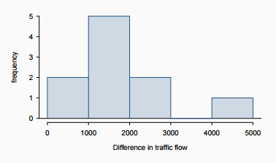
Conditions
Independence: We are told to assume that cases (rows) are independent
Sample size / skew:
The sample distribution does not appear to be extremely skewed, but it’s very difficult to assess with such a small sample size. We might want to think about whether we would expect the population distribution to be skewed or not probably not, it should be equally likely to have days with lower than average traffic and higher than average traffic.
We do not know 𝞼 and n is too small to assume s is reliable estimate for 𝞼

Slide 14
Conditions
Independence: We are told to assume that cases (rows) are independent
Sample size / skew:
The sample distribution does not appear to be extremely skewed, but it’s very difficult to assess with such a small sample size. We might want to think about whether we would expect the population distribution to be skewed or not probably not, it should be equally likely to have days with lower than average traffic and higher than average traffic.
We do not know 𝞼 and n is too small to assume s is reliable estimate for 𝞼
So what do we do when the sample size is small?

Slide 15

Review: what purpose does a large sample server?
As long as observations are independent, and the population distribution is not extremely skewed, a large sample would ensure that...
the sampling distribution of the mean is nearly normal
the estimate of the standard error, as , is reliable

Slide 16
The normality condition
The CLT, which states that sampling distributions will be nearly normal, hold true for any sample size as long as the population distribution is nearly normal

Slide 17
The normality condition
The CLT, which states that sampling distributions will be nearly normal, hold true for any sample size as long as the population distribution is nearly normal
While this is a helpful special case, it’s inherently difficult to verify normality in small data sets

Slide 18
The normality condition
The CLT, which states that sampling distributions will be nearly normal, hold true for any sample size as long as the population distribution is nearly normal
While this is a helpful special case, it’s inherently difficult to verify normality in small data sets
We should exercise caution when verifying the normality condition for small samples. It is important to not only examine the data but also think about where the data come from
For example, ask: would I expect this distribution to be symmetric, and am I confident that outliers are rare?

Slide 19
The 𝒕 distribution
When the population standard deviation is unknown (almost always), the uncertainty of the standard error estimate is addressed by using a new distribution: the 𝒕 distribution.

Slide 20
The 𝒕 distribution
When the population standard deviation is unknown (almost always), the uncertainty of the standard error estimate is addressed by using a new distribution: the 𝒕 distribution.
This distribution also has a bell shape, but its tails are thicker than the normal model’s.

Slide 21
The 𝒕 distribution
When the population standard deviation is unknown (almost always), the uncertainty of the standard error estimate is addressed by using a new distribution: the 𝒕 distribution.
This distribution also has a bell shape, but its tails are thicker than the normal model’s.
Therefore observations are more likely to fall beyond two SDs from the mean than under the normal distribution

Slide 22
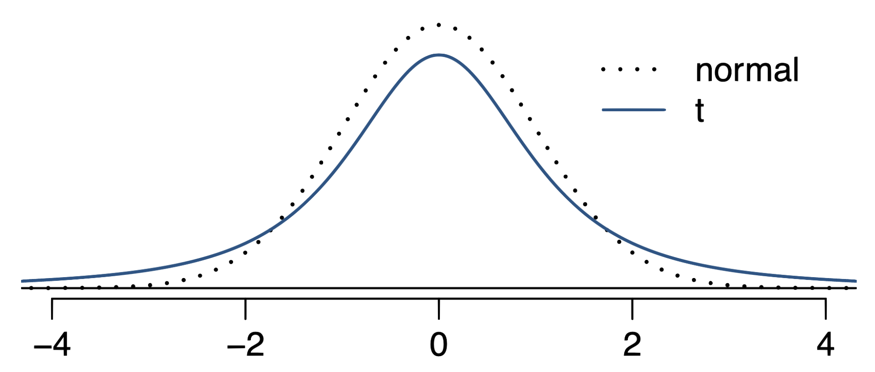
The 𝒕 distribution
When the population standard deviation is unknown (almost always), the uncertainty of the standard error estimate is addressed by using a new distribution: the 𝒕 distribution.
This distribution also has a bell shape, but its tails are thicker than the normal model’s.
Therefore observations are more likely to fall beyond two SDs from the mean than under the normal distribution
These extra thick tails are helpful for resolving our problem with a less reliable estimate the standard error (since n is small)

Slide 23
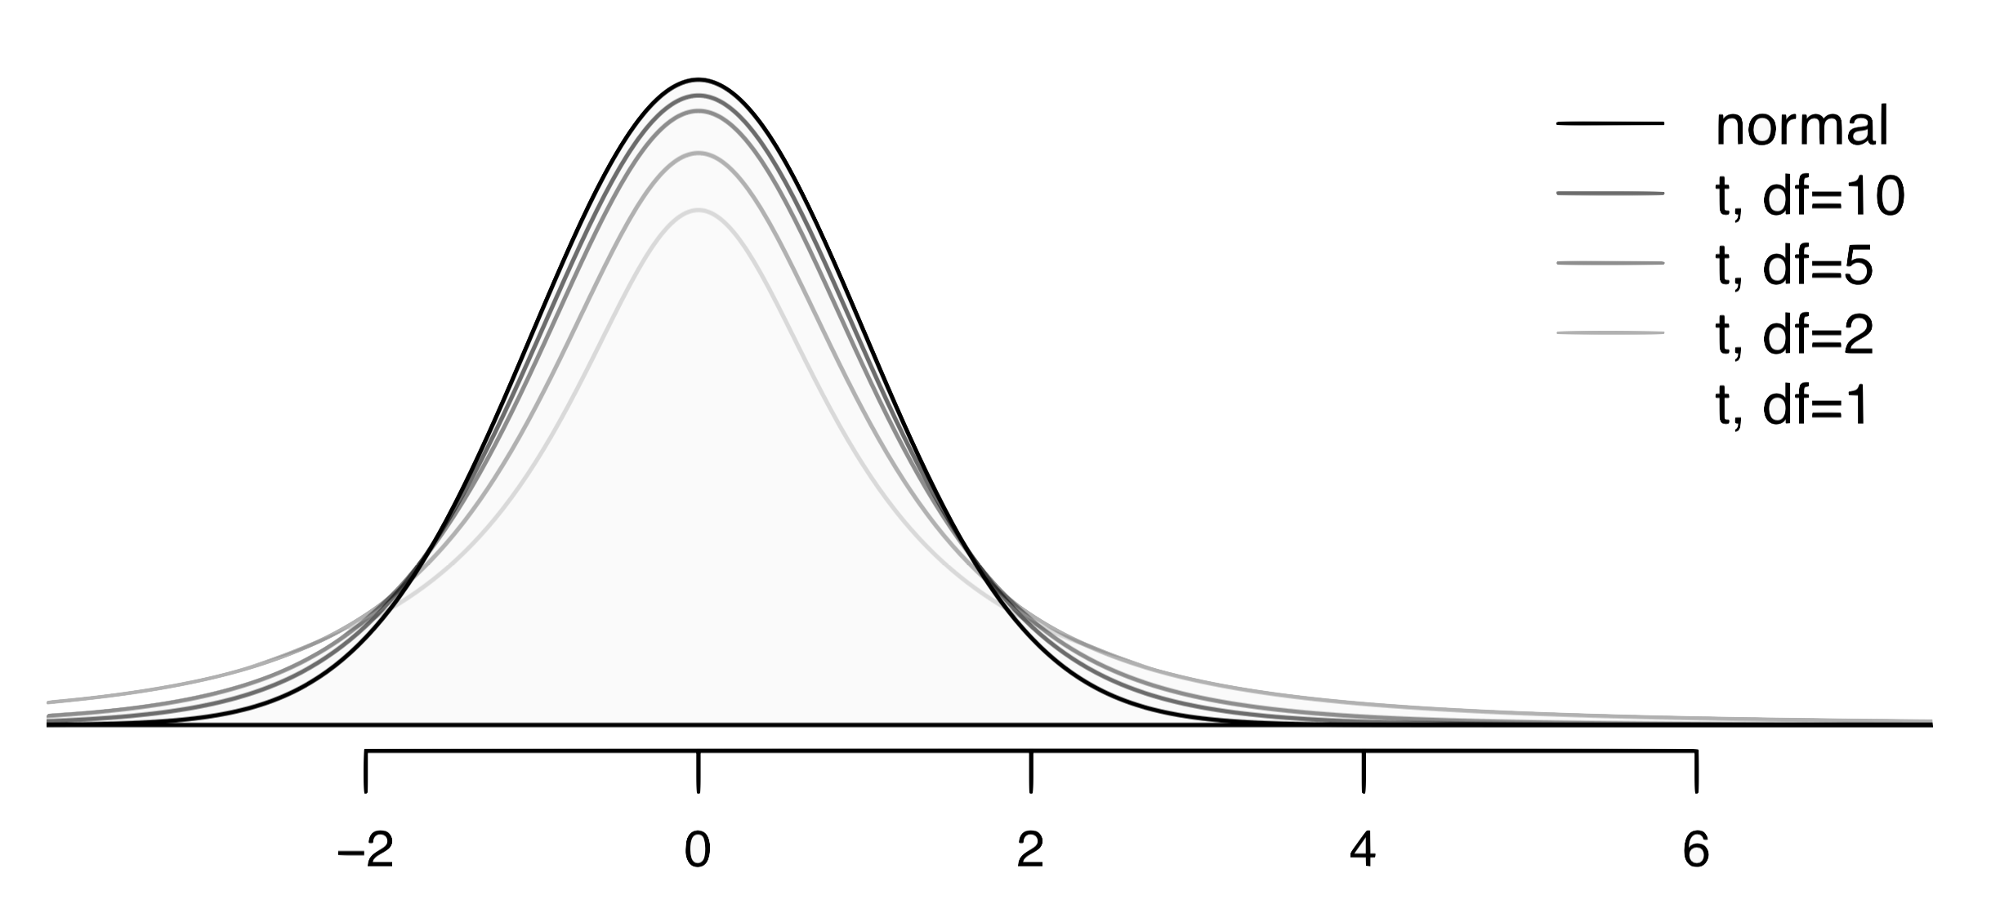
The 𝒕 distribution (cont.)
Always centered at zero, like the standard normal (𝓏) distribution
Has a single parameter: degrees of freedom (df).

Slide 24
The 𝒕 distribution (cont.)
Always centered at zero, like the standard normal (𝓏) distribution
Has a single parameter: degrees of freedom (df).
What happens to the shape of the 𝒕 distribution as df increases?

Slide 25
The 𝒕 distribution (cont.)
Always centered at zero, like the standard normal (𝓏) distribution
Has a single parameter: degrees of freedom (df).
What happens to the shape of the 𝒕 distribution as df increases?
Approaches normal

Slide 26
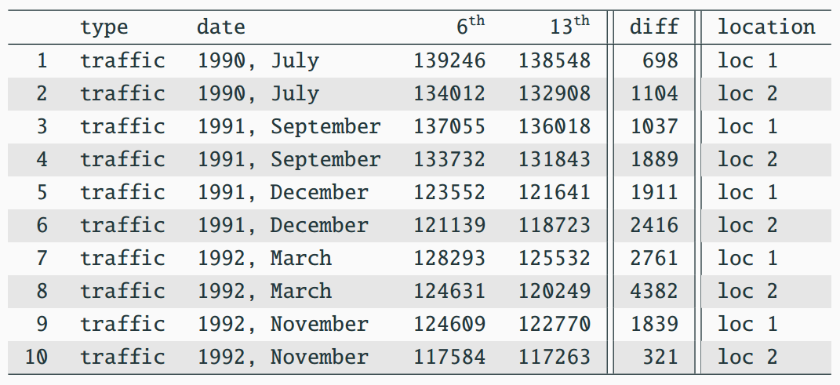


Back to Friday the 13th

Slide 27
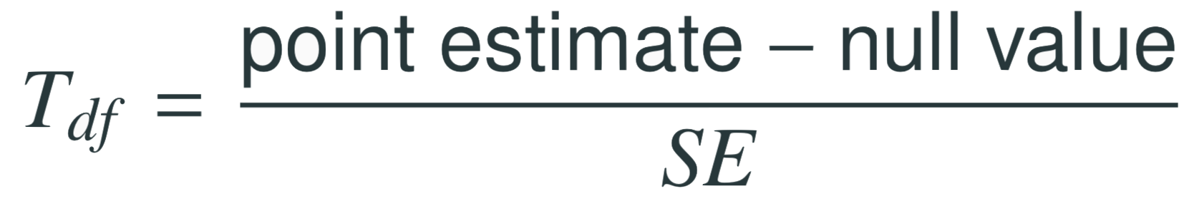
Find the test statistic
Test statistic for inference on a small sample mean
The test statistic for inference on a small sample (n < 50) mean is the 𝑇 statistic with df = n - 1
Note: Null value is 0 because in the null hypothesis we set 𝞵_{diff} = 0

Slide 28
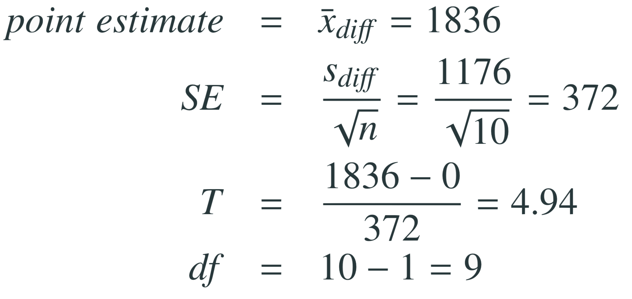
Find the test statistic
Test statistic for inference on a small sample mean
The test statistic for inference on a small sample (n < 50) mean is the 𝑇 statistic with df = n - 1
in context...
Note: Null value is 0 because in the null hypothesis we set 𝞵_{diff} = 0

Slide 29
Find the test statistic
Test statistic for inference on a small sample mean
The test statistic for inference on a small sample (n < 50) mean is the 𝑇 statistic with df = n - 1
in context...
Note: Null value is 0 because in the null hypothesis we set 𝞵_{diff} = 0

Slide 30
Find the test statistic
Test statistic for inference on a small sample mean
The test statistic for inference on a small sample (n < 50) mean is the 𝑇 statistic with df = n - 1
in context...
Note: Null value is 0 because in the null hypothesis we set 𝞵_{diff} = 0

Slide 31
Find the test statistic
Test statistic for inference on a small sample mean
The test statistic for inference on a small sample (n < 50) mean is the 𝑇 statistic with df = n - 1
in context...
Note: Null value is 0 because in the null hypothesis we set 𝞵_{diff} = 0

Slide 32
Finding the p-value
The p-value is, once again, calculated as the area under the tail of the 𝒕 distribution

Slide 33
Finding the p-value
The p-value is, once again, calculated as the area under the tail of the 𝒕 distribution
Using R:
> 2 * pt(4.94, df = 9, lower.tail = FALSE)
[1] 0.0008022394

Slide 34
Finding the p-value
The p-value is, once again, calculated as the area under the tail of the 𝒕 distribution
Using R:
> 2 * pt(4.94, df = 9, lower.tail = FALSE)
[1] 0.0008022394
Using a web app:
http://gallery.shinyapps.io/dist_calc/

Slide 35
Finding the p-value
The p-value is, once again, calculated as the area under the tail of the 𝒕 distribution
Using R:
> 2 * pt(4.94, df = 9, lower.tail = FALSE)
[1] 0.0008022394
Using a web app:
http://gallery.shinyapps.io/dist_calc/
Or when these aren’t available, we can use a 𝒕-table

Slide 36
Conclusion of the test
What is the conclusion of this hypothesis test?

Slide 37
Conclusion of the test
What is the conclusion of this hypothesis test?
Since the p-value is quite low, we conclude that the data provide strong evidence of a difference between traffic flow on Friday 6th and 13th.

Slide 38
What is the difference?
We concluded that there is a difference in the traffic flow between Friday 6th and 13th

Slide 39
What is the difference?
We concluded that there is a difference in the traffic flow between Friday 6th and 13th
But it would be more interesting to find out what exactly this difference is

Slide 40
What is the difference?
We concluded that there is a difference in the traffic flow between Friday 6th and 13th
But it would be more interesting to find out what exactly this difference is
We can use a confidence interval to estimate this difference

Slide 41

Confidence interval for a small sample mean
Confidence intervals are always of the form

Slide 42
Confidence interval for a small sample mean
Confidence intervals are always of the form
ME is always calculated as the product of a critical value and SE

Slide 43

Confidence interval for a small sample mean
Confidence intervals are always of the form
ME is always calculated as the product of a critical value and SE
Since small sample means follow a 𝙩 distribution (and not a 𝓏 distribution), the critical value is a 𝙩* (as opposed to a 𝓏*?).

Slide 44
Finding the critical value (t★)
Using R:
> qt(p = 0.975, df = 9)
[1] 2.262157

Slide 45
Constructing a CI for a small sample mean
Which of the following is the correct calculation of a 95% confidence interval for the difference between the traffic flow between Friday 6th and 13th?
1836 ± 1.96 x 372
1836 ± 2.26 x 372
1836 ± -2.26 x 372
1836 ± 2.26 x 1176

Slide 46
Constructing a CI for a small sample mean
Which of the following is the correct calculation of a 95% confidence interval for the difference between the traffic flow between Friday 6th and 13th?
1836 ± 1.96 x 372
1836 ± 2.26 x 372 (995, 2677)
1836 ± -2.26 x 372
1836 ± 2.26 x 1176

Slide 47

Interpreting the CI
Which of the following is the best interpretation for the confidence interval we just calculated?
We are 95% confident that…
the difference between the average number of cars on the road on Friday 6th and 13th is between 995 and 2,677
on Friday 6th there are 995 to 2,677 fewer cars on the road than on the Friday 13th, on average
on Friday 6th there are 995 fewer to 2,677 more cars on the road than on the Friday 13th, on average
on Friday 13th there are 995 to 2,677 fewer cars on the road than on the Friday 6th, on average

Slide 48
Interpreting the CI
Which of the following is the best interpretation for the confidence interval we just calculated?
We are 95% confident that…
the difference between the average number of cars on the road on Friday 6th and 13th is between 995 and 2,677
on Friday 6th there are 995 to 2,677 fewer cars on the road than on the Friday 13th, on average
on Friday 6th there are 995 fewer to 2,677 more cars on the road than on the Friday 13th, on average
on Friday 13th there are 995 to 2,677 fewer cars on the road than on the Friday 6th, on average

Slide 49
Synthesis
Does the conclusion from the hypothesis test agree with the findings of the confidence interval?
Do you think the findings of this study suggests that people believe Friday 13th is a day of bad luck?

Slide 50
Synthesis
Does the conclusion from the hypothesis test agree with the findings of the confidence interval?
Yes, the hypothesis test found a significant difference, and the CI does not contain the null value of 0.
Do you think the findings of this study suggests that people believe Friday 13th is a day of bad luck?

Slide 51
Synthesis
Does the conclusion from the hypothesis test agree with the findings of the confidence interval?
Yes, the hypothesis test found a significant difference, and the CI does not contain the null value of 0
Do you think the findings of this study suggests that people believe Friday 13th is a day of bad luck?
No, this is an observational study. We have just observed a significant difference between the number of cars on the road on these two days. We have not tested for people’s beliefs

Slide 52

Recap: Inference using the 𝒕-distribution
If 𝞼 is unknown, use the 𝒕-distribution with

Slide 53
Recap: Inference using the 𝒕-distribution
If 𝞼 is unknown, use the 𝒕-distribution with
Conditions:
independence of observations (often verified by a random sample, and if sampling without replacement, n < 10% of population)
no extreme skew

Slide 54

Recap: Inference using the 𝒕-distribution
If 𝞼 is unknown, use the 𝒕-distribution with
Conditions:
independence of observations (often verified by a random sample, and if sampling without replacement, n < 10% of population)
no extreme skew
Hypothesis Testing:

Slide 55

Recap: Inference using the 𝒕-distribution
If 𝞼 is unknown, use the 𝒕-distribution with
Conditions:
independence of observations (often verified by a random sample, and if sampling without replacement, n < 10% of population)
no extreme skew
Hypothesis Testing:
Confidence interval:

Slide 56
Recap: Inference using the 𝒕-distribution
If 𝞼 is unknown, use the 𝒕-distribution with
Conditions:
independence of observations (often verified by a random sample, and if sampling without replacement, n < 10% of population)
no extreme skew
Hypothesis Testing:
Confidence interval:
Note: The example we used was for paired means (difference between dependent groups). We took the difference between the observations and used only these differences (one sample) in our analysis

Slide 57
Find more resources at openintro.org/os, including
Slides
Videos
Statistical Software Labs
Discussion Forums (free support for students and teachers)
Learning Objectives
Teachers only content is also available for Verified Teachers, including
Exercise solutions
Sample exams
Ability to request a free desk copy for a course
Statistics Teachers email group
Questions? Contact us.

Slide 58
Extra Slides from the OS3 section on one-sample means

Slide 59
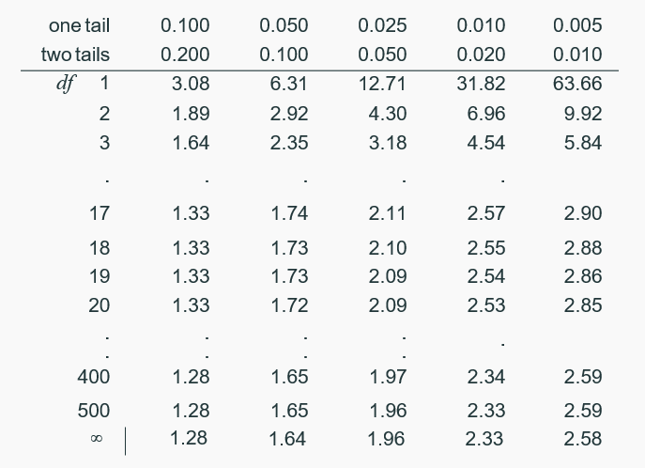
Finding the p-value
Locate the calculated 𝑇 statistic on the appropriate df row, obtain the p-value from the corresponding column heading (one or two tail, depending on the alternative hypothesis).

Slide 60
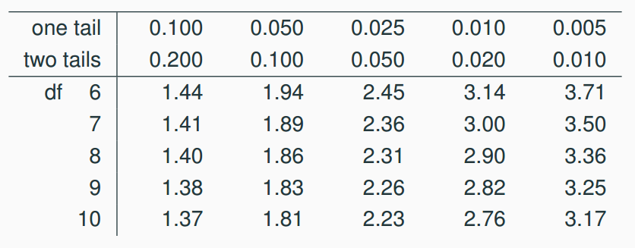
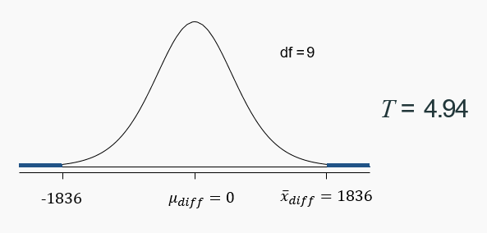
Finding the p-value (cont.)

Slide 61
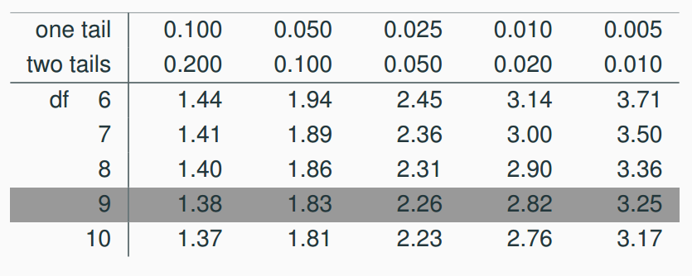
Finding the p-value (cont.)

Slide 62
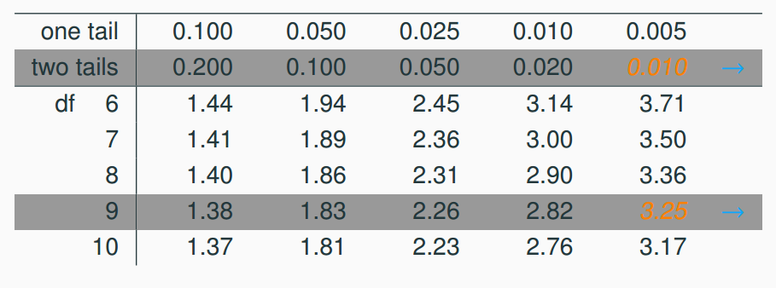
Finding the p-value (cont.)

Slide 63
Finding the p-value (cont.)
What is the conclusion of the hypothesis test?

Slide 64
Finding the p-value (cont.)
What is the conclusion of the hypothesis test?
The data provides convincing evidence of a difference between traffic flow on Friday 6th and 13th

Slide 65
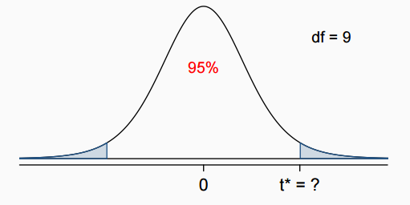
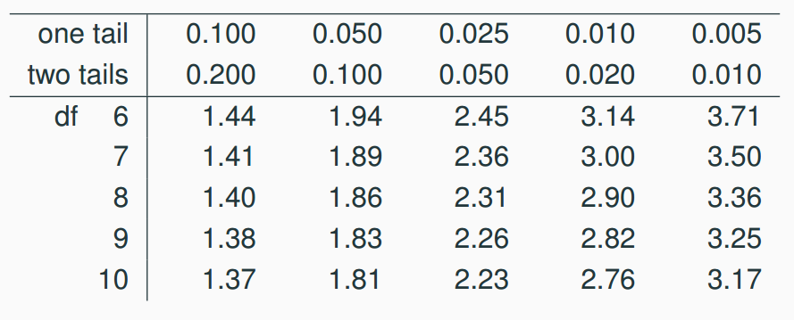
Finding the critical 𝒕 (𝒕*)
n = 10, df = 10 - 1 = 9, t* is at the intersection of rows df = 9 and two tail probability 0.05

Slide 66
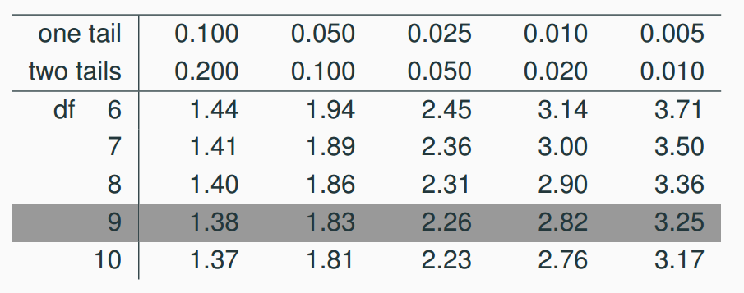
Finding the critical 𝒕 (𝒕*)
n = 10, df = 10 - 1 = 9, t* is at the intersection of rows df = 9 and two tail probability 0.05

Slide 67
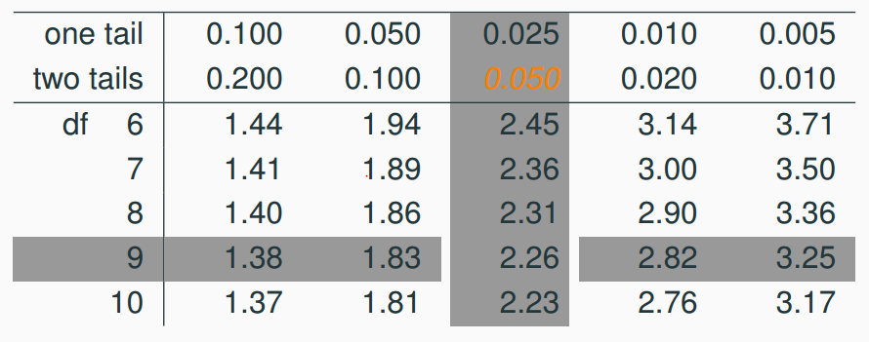
Finding the critical 𝒕 (𝒕*)
n = 10, df = 10 - 1 = 9, t* is at the intersection of rows df = 9 and two tail probability 0.05

Slide 68
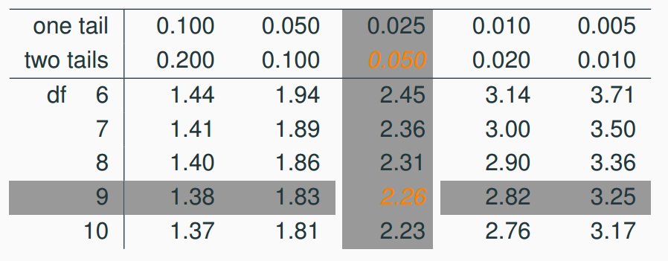
Finding the critical 𝒕 (𝒕*)
n = 10, df = 10 - 1 = 9, t* is at the intersection of rows df = 9 and two tail probability 0.05

